Slide 1
6- Finding Items

Slide 2
listObject.Index(anObject) 3
anObject in listObject | in operator 5
listObject.count(anObject) 6

Slide 3

listObject.Index(anObject)
find the index of a given object in a list

Slide 4

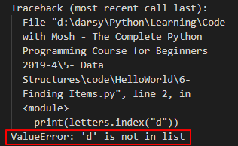
This behavior is different from a lot of programming languages out there

Slide 5
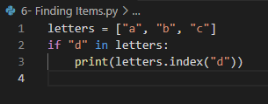
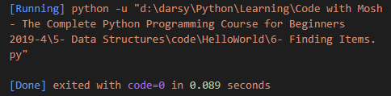
anObject in listObject | in operator
C based languages return negative one if you try to get the index of an object that doesn't exist in the list.
in Python we get an error. to prevent this you should check to see if the given object exists in the list And for that we use the in operator

Slide 6
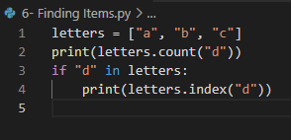

listObject.count(anObject)
return the number of occurrences of the given item in this list

